Slide 1
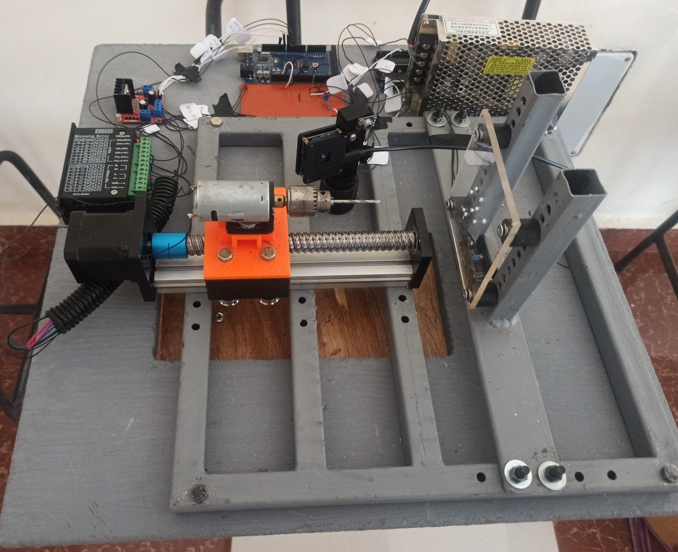
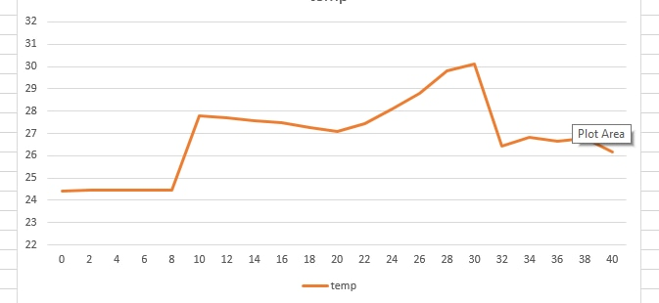
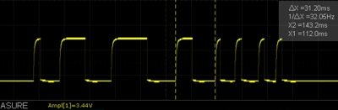
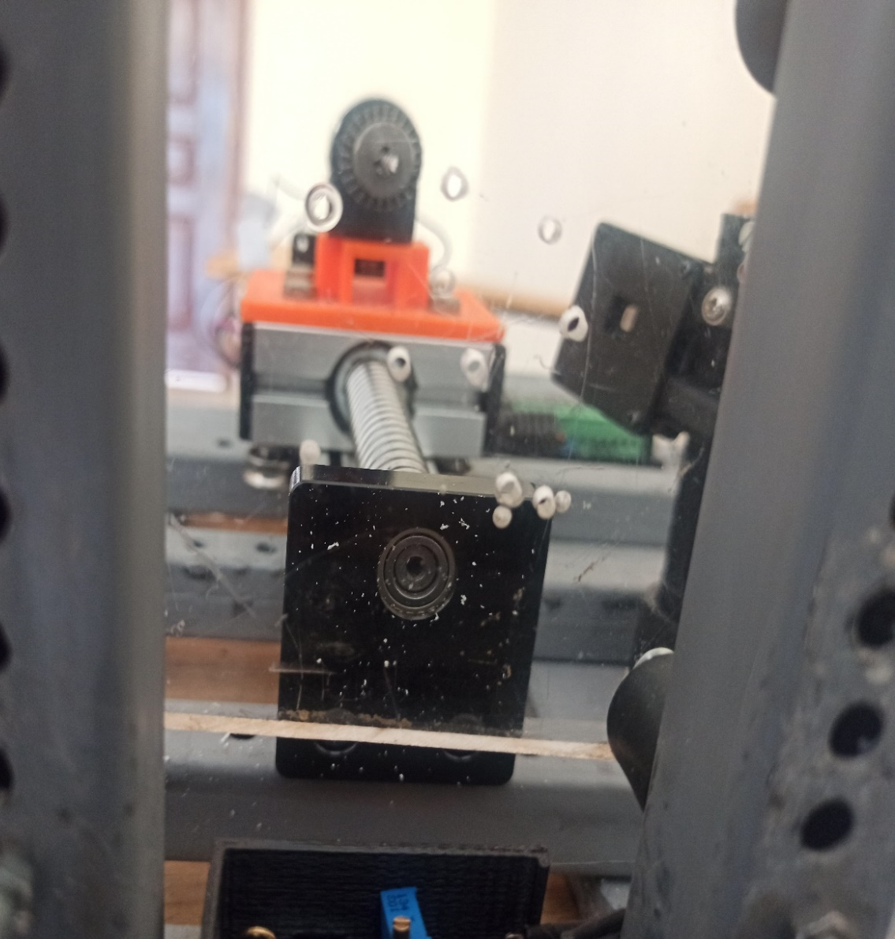
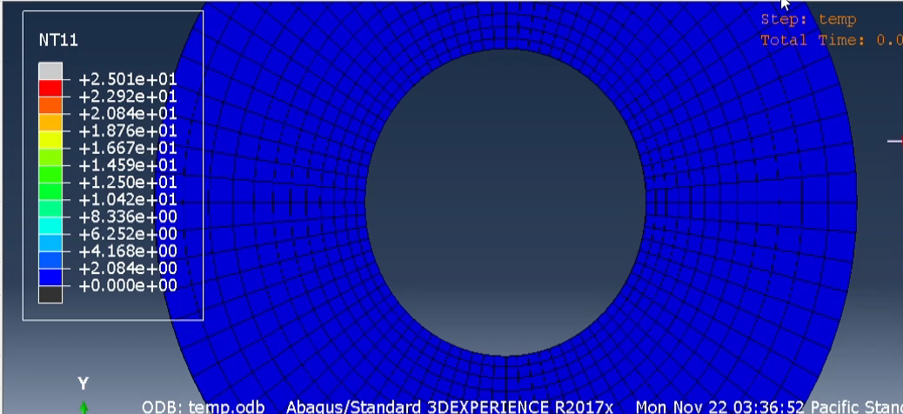
DEVELOPMENT OF AN AUTOMATED DRILL
Members
Adegu Gloria Vuhya
2. Nafula Faith
3. Onyuna Aggrey Omondi
4. Isaac Venant Mwondi
z
Supervisor: Dr. Titus Mulembo
OVERVIEW
JUSTIFICATION
In the medical industry, the drilling of bone is a common procedure in orthopaedical surgery to produce holes for screw insertion to fixate the fracture devices and implants.
PMMA has similar properties to the bone hence this study can be used in orthopedic drilling research.
INTRODUCTION
Acrylic polymers are currently widely used in industry in all kinds of applications due to their desired properties.
The aim of this project is to develop an automated drilling machine that measures the drilling parameters required for drilling different hole sizes on Poly-methyl-meth-acrylate(PMMA).
PROBLEM STATEMENT
This project aims to develop an inexpensive automated drill to address all the challenges faced during the drilling of PMMA. In contrast with the available CNC drilling machines, it will have the advantages of lower costs, more convenient maintenance, and more straightforward to use hence producing quality in addition to curbing bit breakage for thin drill bits and drill bit wear for thick drill bits
OBJECTIVES
To design and fabricate a mechanical drilling system for optimal drilling parameters that ensure production of quality thin long holes.
To program the sensors and actuators for the operation.
EXPERIMENTAL WORK
STEPS
VARIABLES
FABRICATED RIG
Determination of drilling control parameters
Program on Arduino IDE
Run the experiments
Results
Evaluation and analysis
Feed rate
Spindle speed
Drill bit diameter
DRILLING PARAMETERS
 | DRILL DIAMETER | FEED RATE(mm/min) | SPINDLE SPEED (RPM)
Level 1 | 2 mm | 0.1325 | 10352
Level 2 | 4 mm | 0.2625 | 9411
Level 3 | 6 mm | 0.39375 | 7058
RESULTS
TEMPERATURE
VIBRATIONS
Temperature values from the temperature sensor.
This is the expected behavior of the 801S vibration sensor module, it behaves in the same way as its output switches momentarily from LOW to HIGH depending on the vibrations during the drilling process.
Temperature simulation using FEA .
CONCLUSION
The automated drill was able to drill as expected, and the parameters for optimum drilling were determined for production of quality holes.
Temperature and vibration were able to be monitored during the drilling process.
The vibration signals are considered to contain reliable features for monitoring drill wear and breakage.
It is also time effective, inexpensive and easy to use.

